Slide 1
Modeling Recruitment in Stock Synthesis
Ian Taylor
CAPAM Recruitment Workshop, Miami
October 30, 2017
DRAFT presentation uploaded for backup purposes only

Slide 2
Big Picture
Stock synthesis (SS) has lots of options, especially related to recruitment
Most SS models have recruitment deviates around a parametric stock-recruit relationship
Age-structured surplus production models can be achieved by fixing deviations to zero
Recruits can by partitioned by area, season, etc., but there is always a single spawning stock (no metapopulation dynamics)

Slide 3
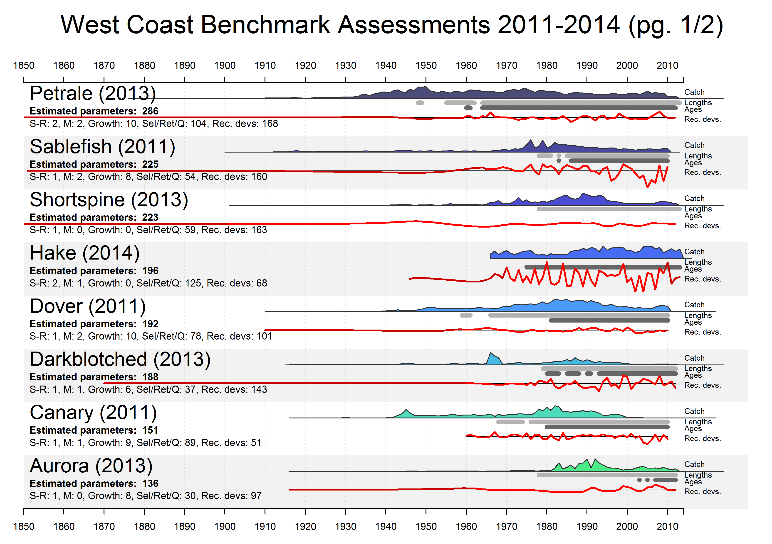
Summary of estimated parameters
Catch (scaled)
Years with length or age data
Recruitment deviations
Modeling recruitment over the full history of commercial fishing

Slide 4
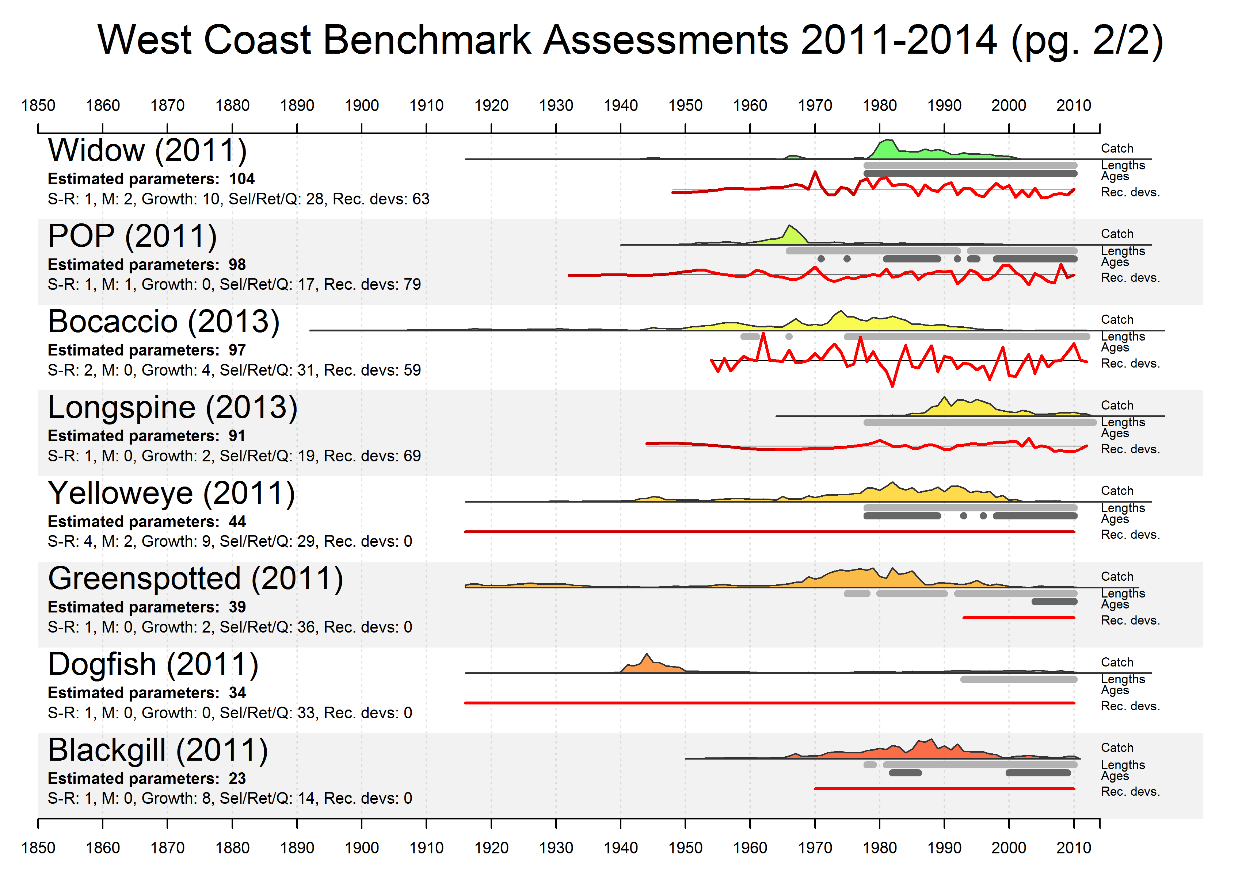

Slide 6
Motivation for use of stock-recruit relationships
Provides underlying structure allowing recruitment estimation outside range of composition data
Many alternative approaches are available
Stock Synthesis includes enough options to allow comparison among approaches

Slide 7
Stock Recruit Relationships

Slide 8
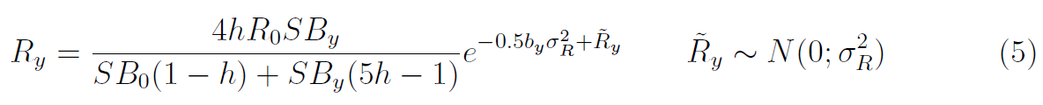
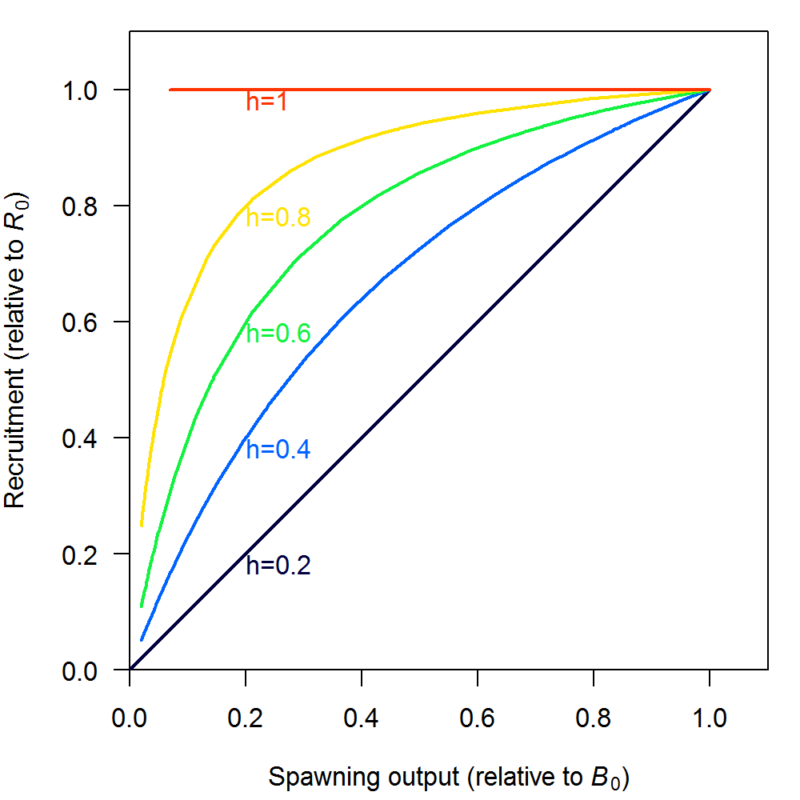
Beverton-Holt
Beverton-Holt is most common choice by far
R₀ is key scale parameter for most models,
h difficult to estimate, often doesn’t have strong impact on fit to data, but plays big role in reference points and forecasts

Slide 9
#_LO HI INIT PRIOR PR_SD PR_type PHASE ... # parm_name
5 20 10.6 10 5 0 1 ... # SR_LN(R0)
0.2 1 0.6 0.718 0.158 0 3 ... # SR_BH_steep
0.5 1.2 0.5 0.67 99 0 -6 ... # SR_sigmaR
-5 5 0 0 99 0 -50 ... # SR_regime
0 2 0 1 99 0 -50 ... # SR_autocorr

Slide 10
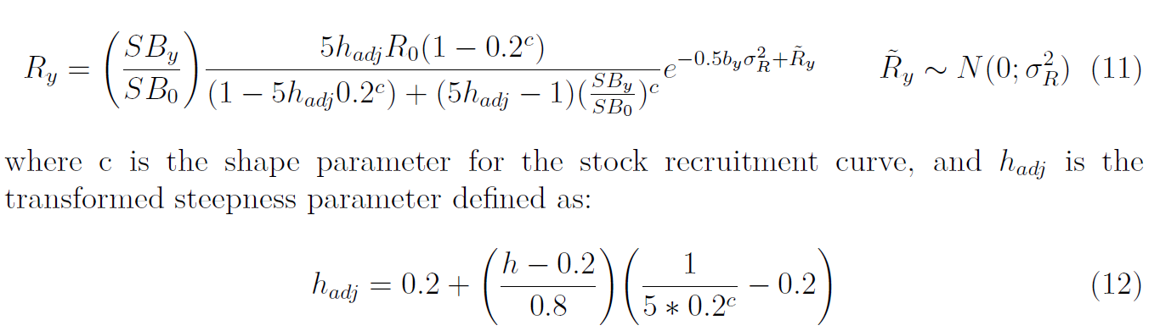
Shepherd
Shepherd, G. 1982. A versatile new stock-recruitment relationship for fisheries, and the construction of sustainable yield curves. ICES J. Mar. Sci. 40: 67-75.

Slide 11
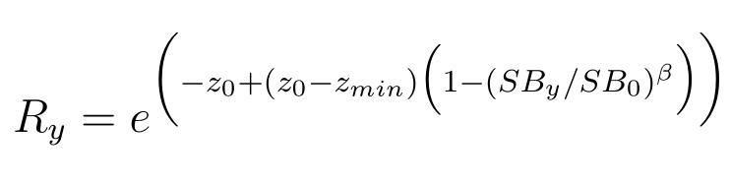
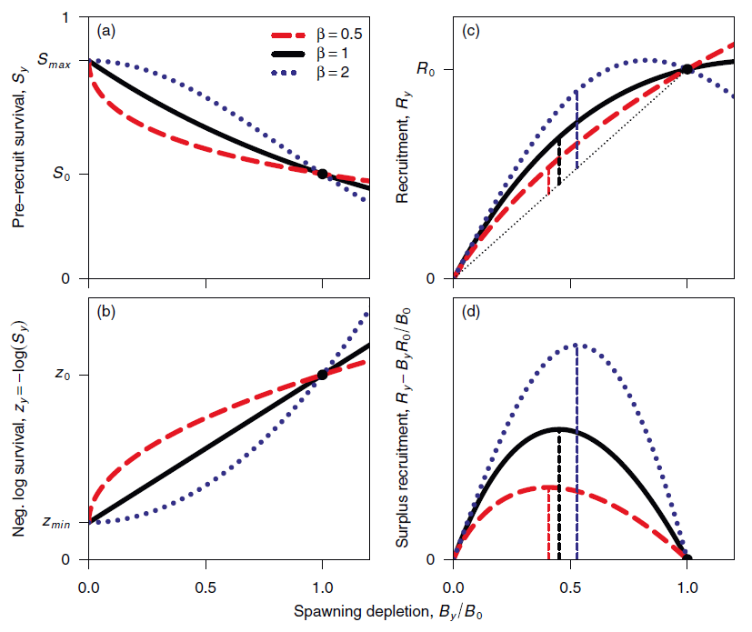
Low Fecundity Stock Recruit Relationship (a.k.a. Maunder-Taylor-Methot, or Survival-based recruitment)
Has been applied to low-fecundity species, but shape of survival curve may be useful elsewhere (see Maunder and Piner’s “Quest for the holy grail”)
Taylor et al. (2013) A stock-recruitment relationship based on pre-recruit survival, illustrated with application to spiny dogfish shark. Fisheries Research 142: 15– 21.

Slide 12
Recruitment deviations
SigmaR
Eras (Init/Early, Main, Late/Forecast), and
Bias adjustment

Slide 13
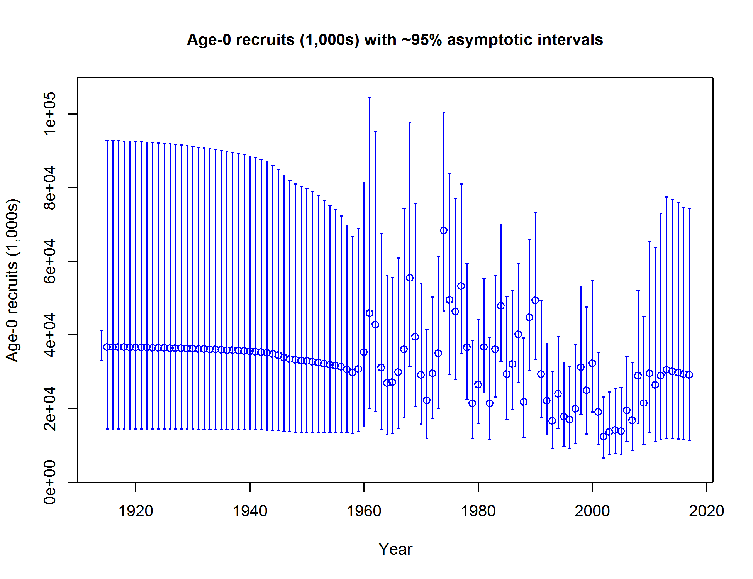
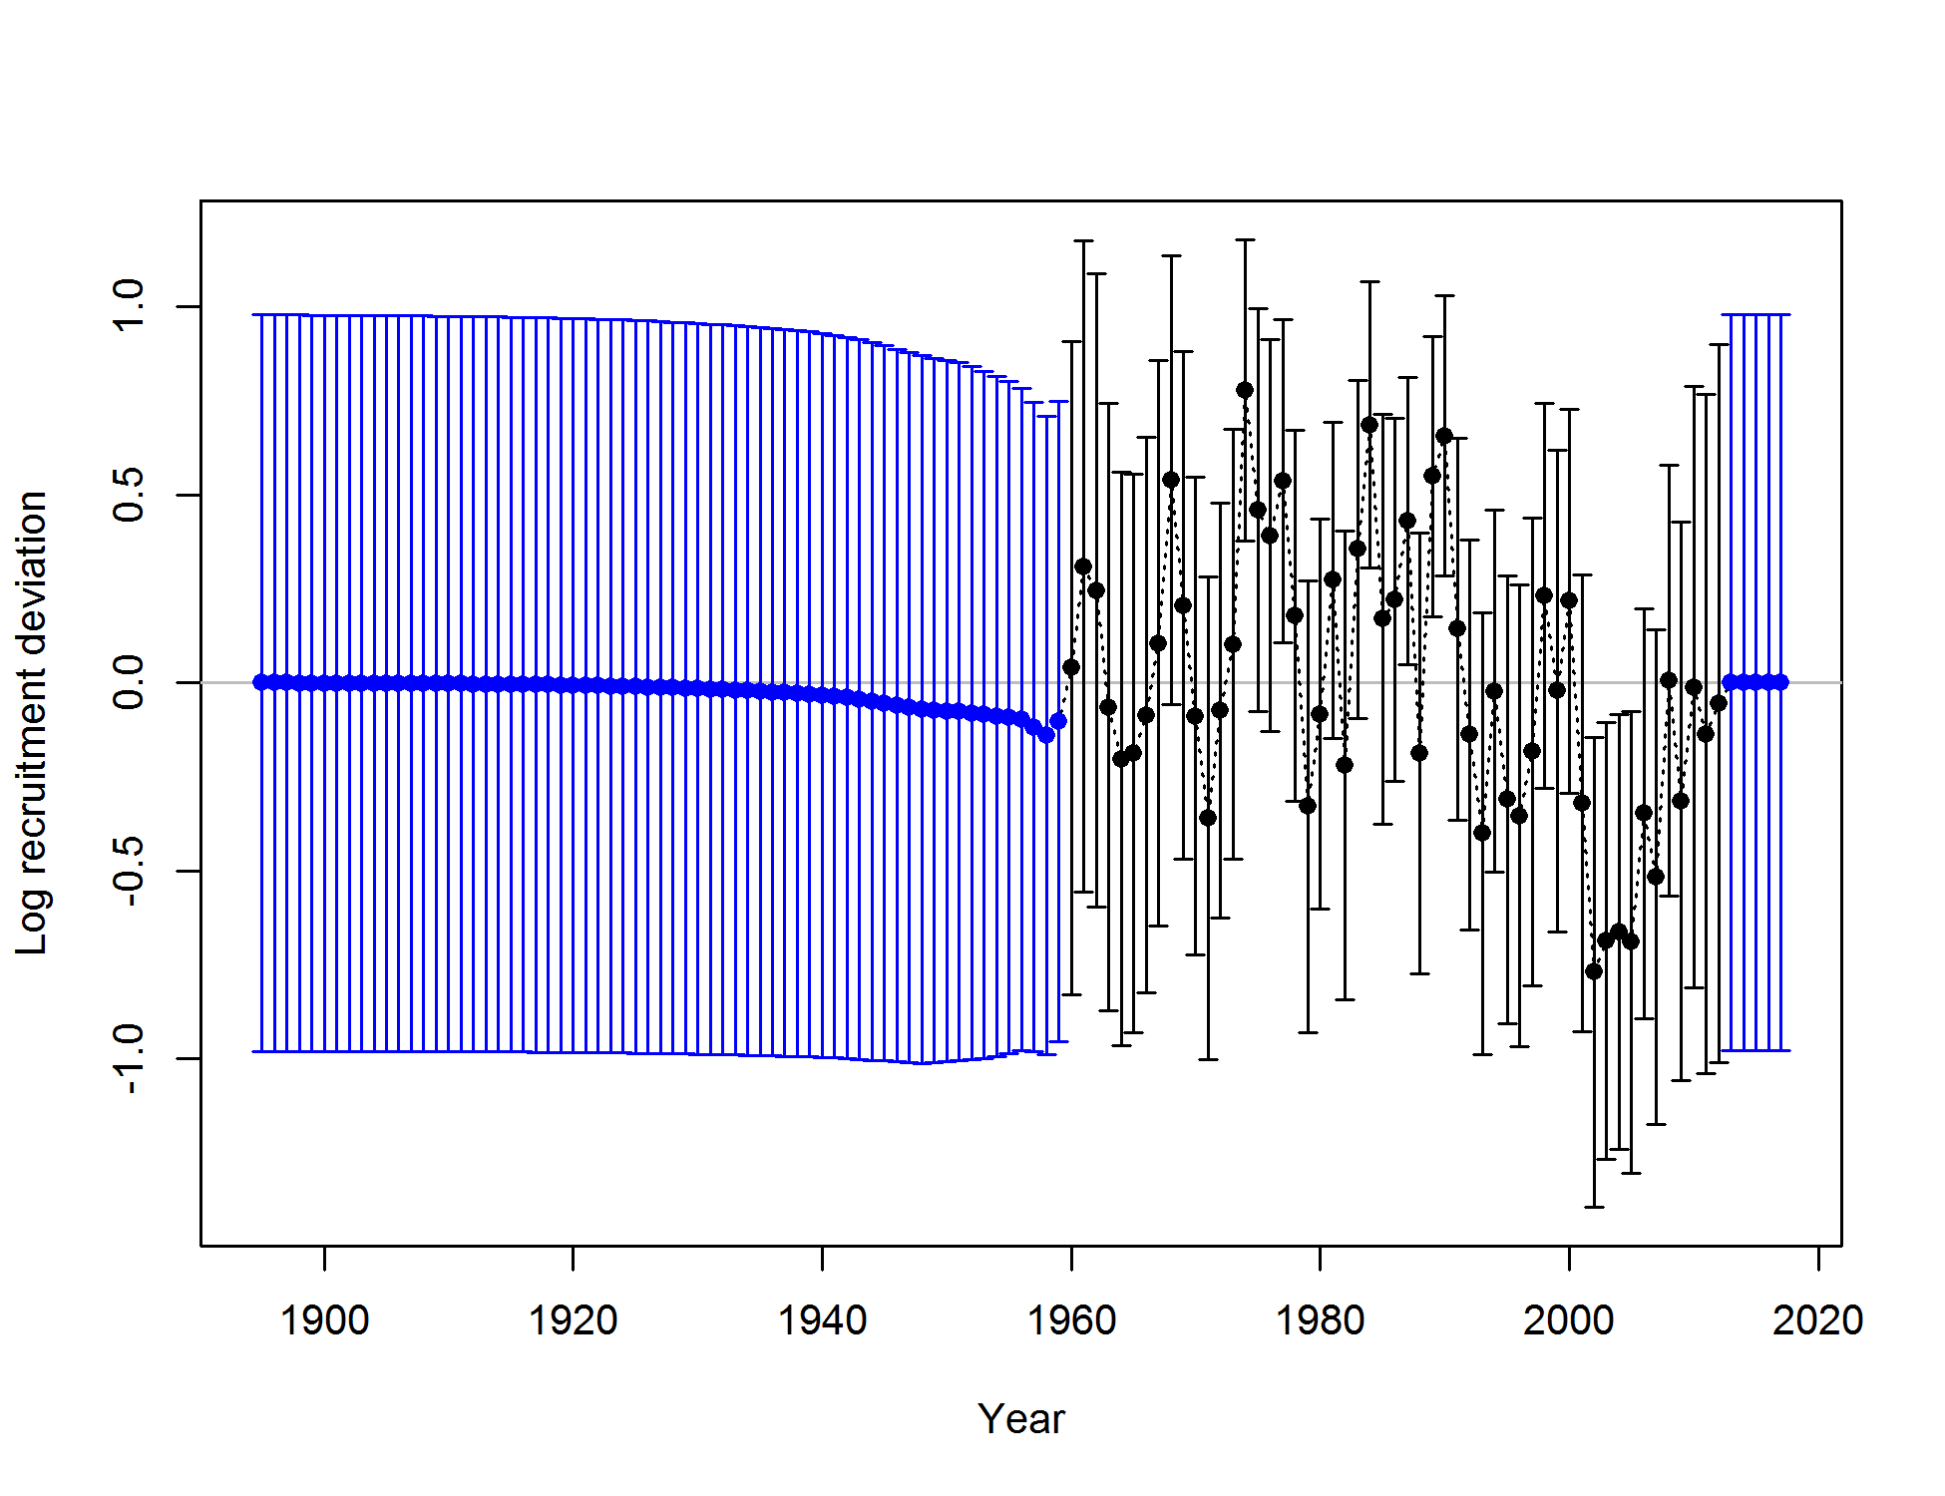

Slide 14
Settlement events and Apportionment of recruitment
(to multiple areas, growth patterns, or settlement events)

Slide 15
Time-varying stock-recruit relationships (regimes)
* Initial year vs. equilibrium (R1 in 3.24) * Environmental links * Forecasting with high or low recruitments

Slide 16
Autocorrelation and impact on forecast (see Johnson et al. 2017)

Slide 17
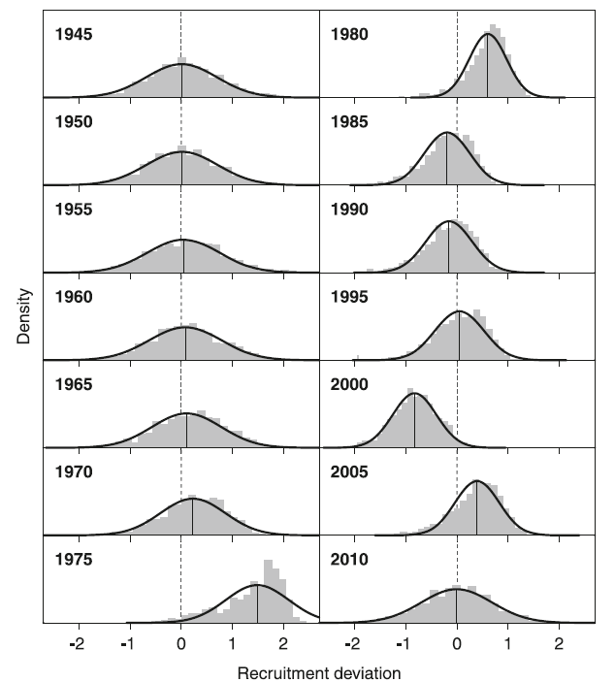
Recruitment and model uncertainty in MCMC vs. MLE estimates
Bayesian estimation using MCMC simplifies some elements of recruitment estimation
No bias adjustment necessary: SS automatically overrides settings
Distributions are typically skewed: more information about big recruitments than small ones
Methot, R.D. and Taylor, I.G., 2011. Adjusting for Bias due to Variability of Estimated Recruitments in Fishery Assessment Models. Can. J. Fish. Aquat. Sci. 68, 1744–1760.
Stewart, I.J., A. Hicks, I.G. Taylor, J.T. Thorson, C. Wetzel, and S. Kupschus. 2013. A comparison of stock assessment uncertainty estimates using maximum likelihood and Bayesian methods implemented with the same model framework. Fish. Res. 142, pp 37–46.

Slide 18
Simulating with random recruitment
SS has built-in parametric bootstrap capability for random data generation, but most analyses benefit from random recruitment
Option 1: modify the ss.par file
Option 2: input in control file
122 #_read_recdevs
#_end of advanced SR options
# read specified recr devs
#_Yr Input_value
1895 -0.06873
1896 -0.97538
1897 0.11130
...
Control file input can be facilitated by r4ss function: > SS_recdevs(fyr=1895, lyr=2016, dir=mydir)
[1] making recdev phase to negative: -2
[1] rescaling recdevs vector so yrs 1895:2016
[1] have mean 0 and std. dev. = sigmaR = 0.5
[1] wrote new file: control_modified.ss

Slide 19
Recap of changes from 3.24 to 3.30 (also mentioned throughout)

Slide 20
Ideas for the future:
Area-specific spawning biomass
Density-dependent recruitment variability
Semi-parametric stock-recruit curve

Slide 21
References
Methot, R.D. and Taylor, I.G., 2011. Adjusting for Bias due to Variability of Estimated Recruitments in Fishery Assessment Models. Can. J. Fish. Aquat. Sci. 68, 1744–1760.
Shepherd, G. 1982. A versatile new stock-recruitment relationship for fisheries, and the construction of sustainable yield curves. ICES J. Mar. Sci. 40: 67-75.
Stewart, I.J., A. Hicks, I.G. Taylor, J.T. Thorson, C. Wetzel, and S. Kupschus. 2013. A comparison of stock assessment uncertainty estimates using maximum likelihood and Bayesian methods implemented with the same model framework. Fish. Res. 142, pp 37–46.
Taylor, I.G., V. Gertseva, R.D. Methot, and M.N. Maunder. 2013. A stock-recruitment relationship based on pre-recruit survival, illustrated with application to spiny dogfish shark. Fish. Res. 142, pp 15–21.

